Slide 1

Hive Inspection and Varroa Detection
By Louis de Lavenne de Choulot de Chabaud-la-Tour

Slide 2
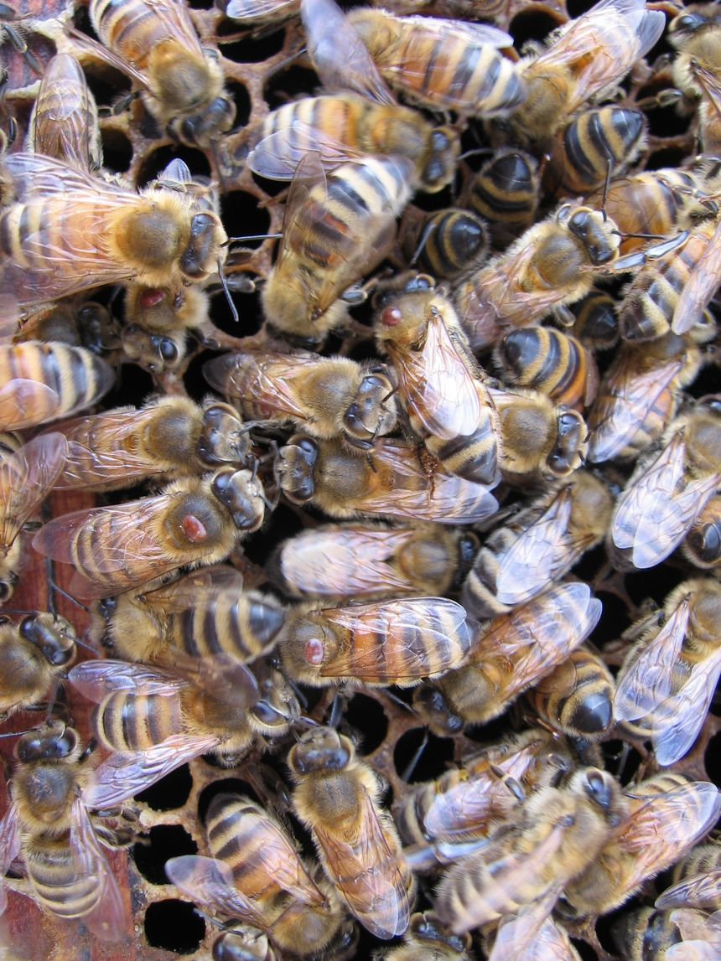
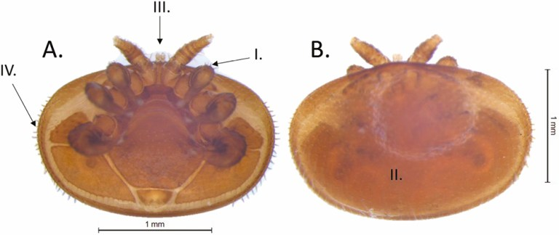
INTRODUCTION

Slide 3
Problem
The detection of varroa is always late, how could we prevent the destruction of beehives with early detection ?

Slide 4
Project Objectives
Detect Varroa early upon it’s apparition
Learn more about AI and it’s different purposes
Make an easy to use poduct
Have fun

Slide 5
Overall Timeline
June 2021 - Get the project accepted
October 2021 – End of Redesign period and precise the goal of the project: Shorten the number of wanted software to develop for it to hold in 5 years
June 2022 – First version
August 2022 – End of Testing Period
October 2022 – End of New guidelines making
June 2023 – Second and Final Version

Slide 6
First Year: Research and Planning
Search for a project
First proposition Laser hornet killer X
Second proposition Varroa detector V
Planning

Slide 7
FIRST VERSION

Slide 8
Assumption
The beekeeper can have a micro camera on the beehive with less than 50cm away from the bees
The AI need to purely recognize varroa on one bee
The AI will work with a specific hardware
The AI will be made with material learnt at ALGOSUP
AI will be continuously working on a video stream

Slide 9

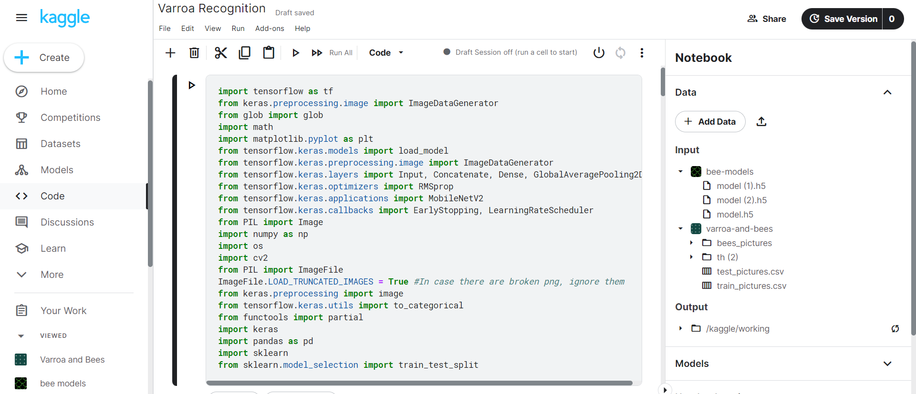
Tensorflow and kaggle

Slide 10
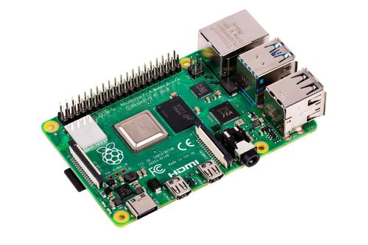
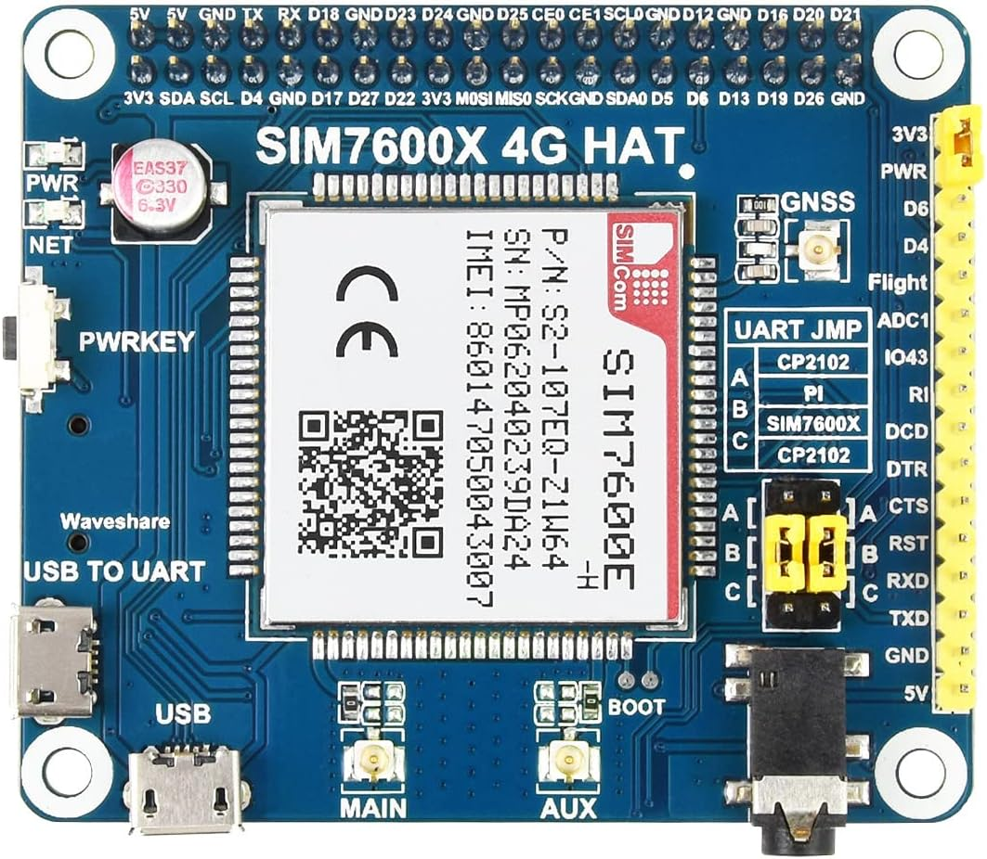
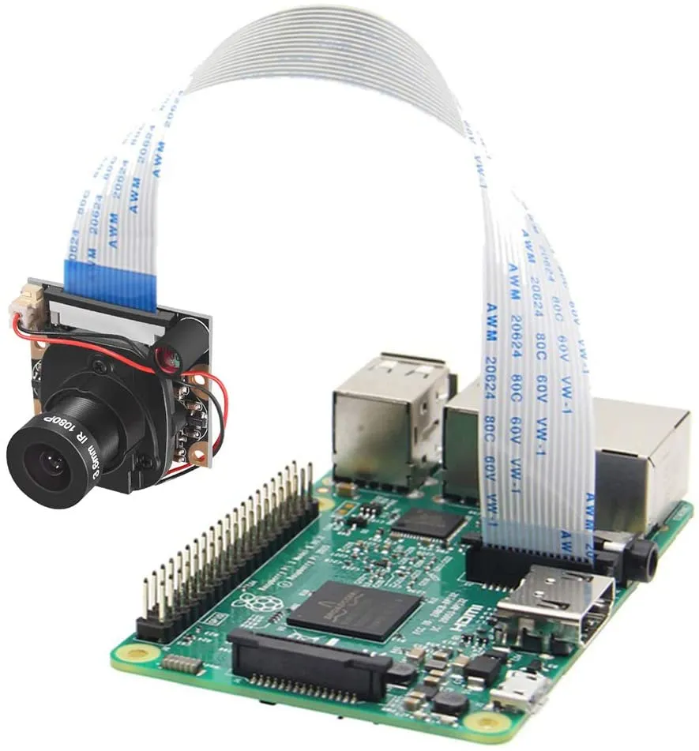
Hardware
Raspberry PI
LTE Module (connectivity)
Camera

Slide 11
What went well
Working AI
70% Accuracy
Usable
Compatible with selected hardware

Slide 12
Limitations
Hardware specific = Shortage sensitive
Specific image size
2 seconds prediction time
Needed strict software
One prediction One bee

Slide 13
Conclusion of version 1
The project should not be hardware sensitive
The image size should be variable
A 30fps stream of data with 2 seconds per frame is not viable
A prediction should be able to have multiple bees on one screen

Slide 14
Second version

Slide 15
Assumption
The beekeeper can have a micro camera on the beehive with less than 50cm away from the bees
The AI will be able to run on any hardware
The AI will be made for real camera screen sizes
The AI will be made with latest technologies from researches
AI will be working on pictures taken from a video stream

Slide 16

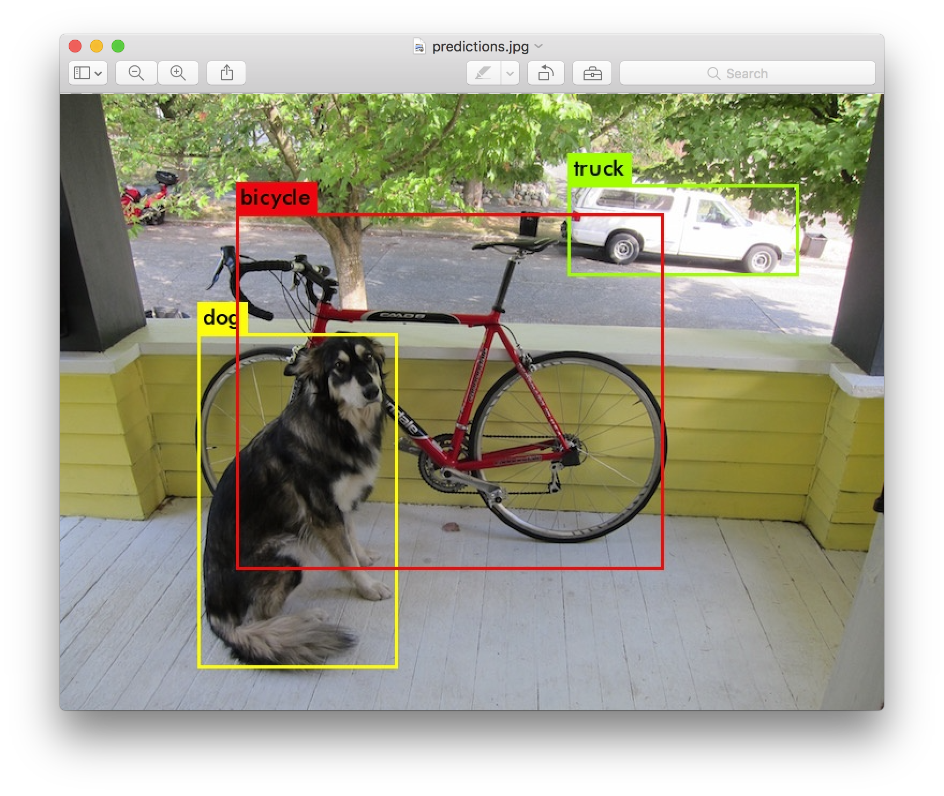
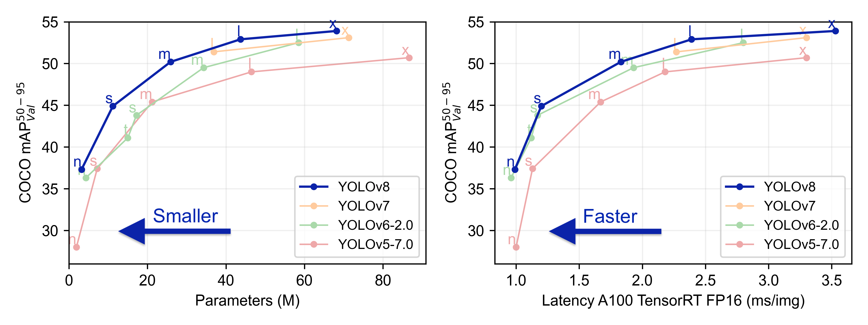
YOLOV5 / You Only Look Once

Slide 17

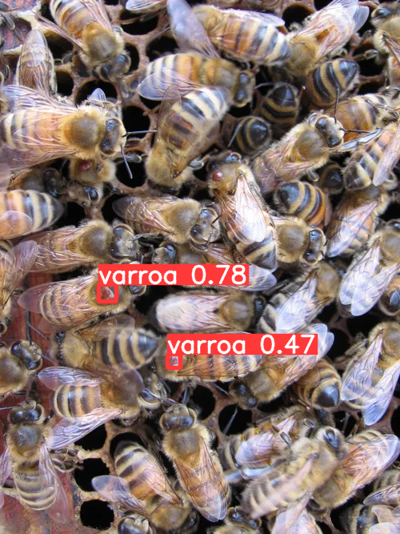
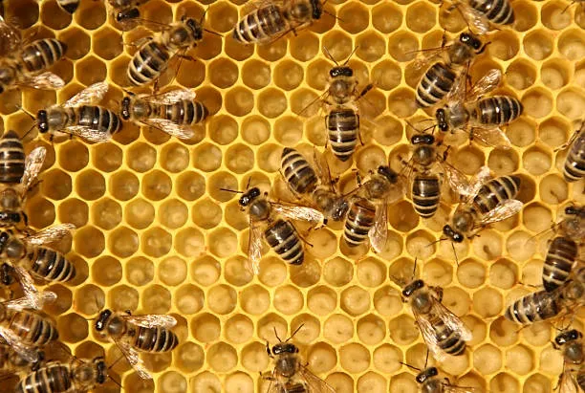

What went well
Working AI
Increased Accuracy
A maximum of hardwares supported
Small model 14mb instead of 175mb
Fast – less than a second per run
Image prediction is better on the hardware and for the energy consumption
Any camera size works
No external hardware needed to run the model
Continuous training made easy
Boxes around varroa

Slide 18
Conclusion of V2
All objectives completed !
Easy to implement

Slide 19
Then, what to improve or add?
Model predictions
Global platform for global view
One-click-install
Varroa species recognition

Slide 20
THANK YOU FOR LISTENING
If you have questions, feel free to ask !
Louis de Choulot

